Slide 1



Find Your Paradise!
By :
Code Mavericks
Skanda P R – RVCE22BCS207
Talasila Dheeraj – RVCE22BCS151
Bandaru Jnyanadeep - RVCE22BCY043

Slide 2
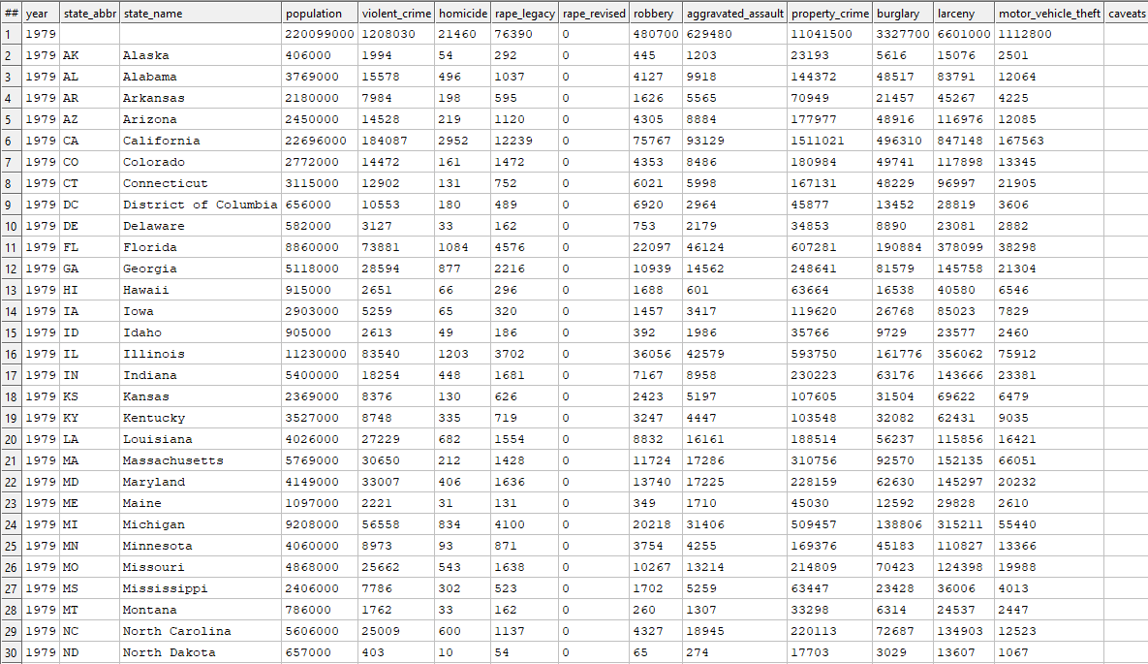
Crime Dataset
First we created a file called BWR_AnalyzeCrime where we analysed the Crime Dataset and calculated the Average of all the crimes with respect to all the states of US and also found the ratios of these averages to the total population of that particular state. Here we used the GROUP function to calculate the averages of crime of a particular state.

Slide 3
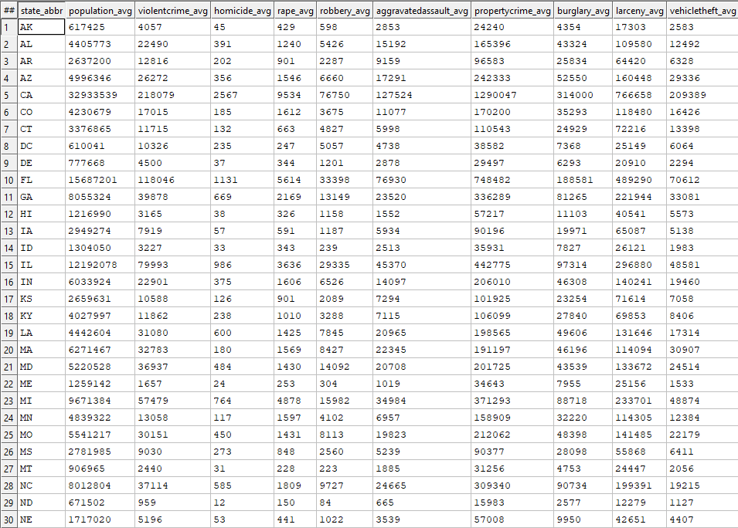
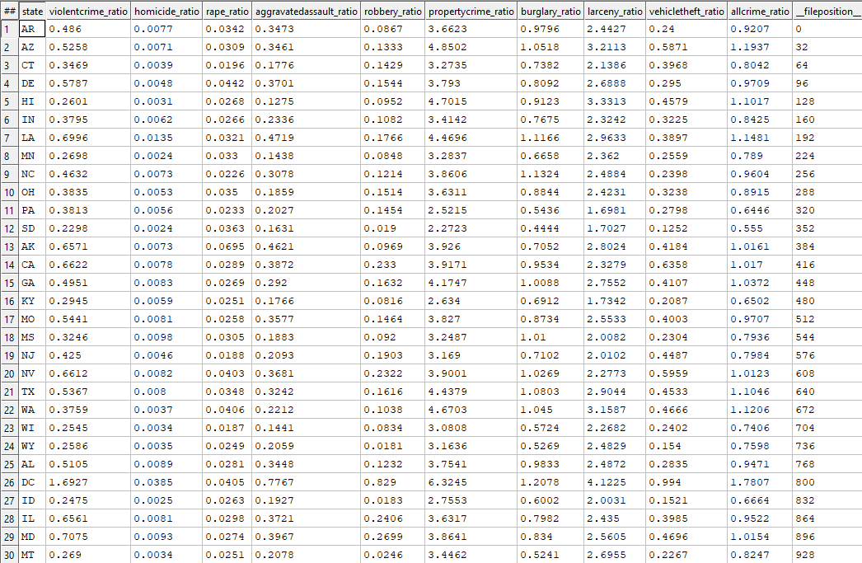
Crime Dataset
These two are the New dataset obtained after analysis.

Slide 4
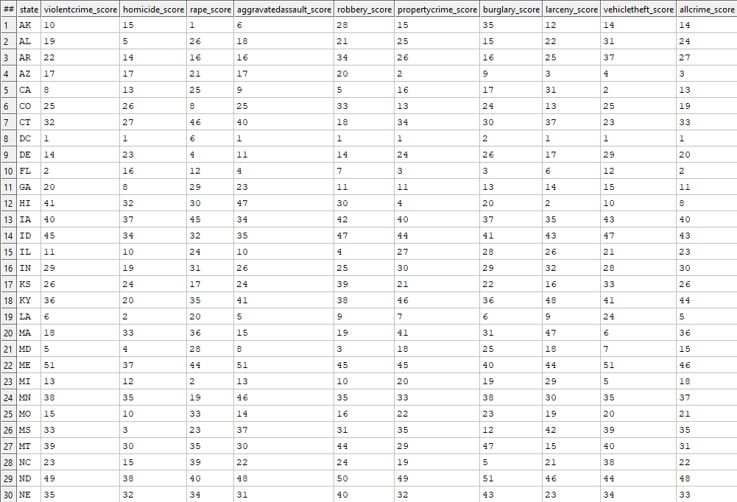
Crime Dataset
Next we created a file called BWR_BuildCrimeScores where we gave Scores or Ranks to the states based on the crime ratio of that state. We used ITERATE function to carry out this process because it is used to loop the dataset and perform operations such that the Scores are stored in a sequential order with respect to the Crime ratios.
Here the Score/Rank is low for higher values of the ratios.

Slide 5
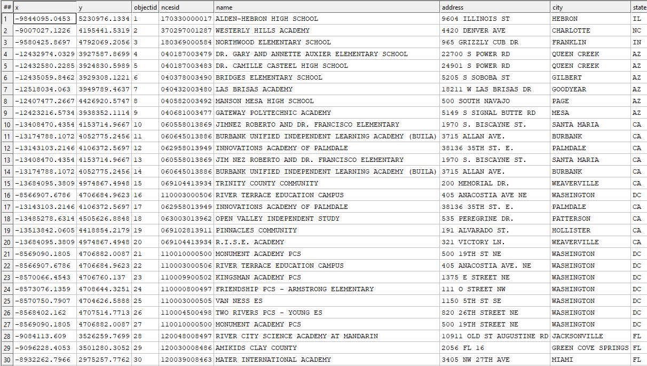
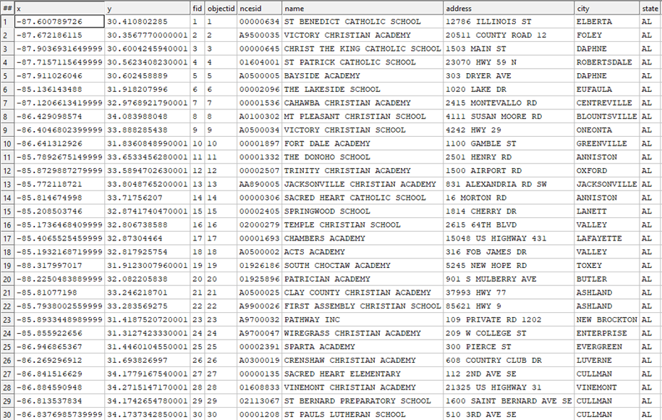
Education Dataset
First we took the Public school dataset and Private school dataset and created a new record set which marks these dataset accordingly. This code we stored it in BWR_BuildSchools.
Next we took this record set for the dataset to analyse the dataset.

Slide 6
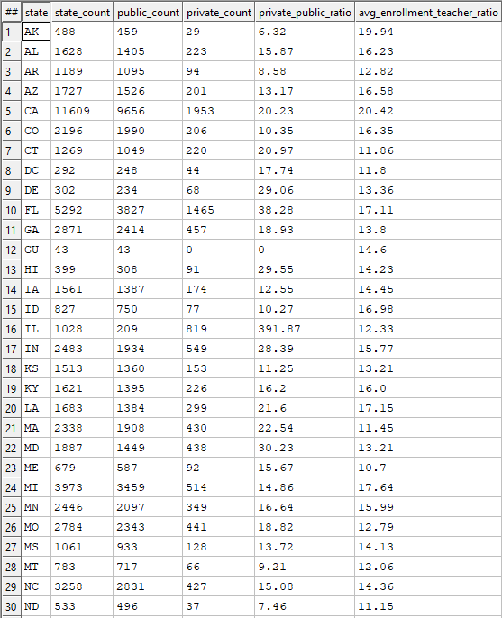
Education Dataset
In BWR_AnalyzeSchools file, we found out the number of public and private schools in a state using COUNT and GROUP functions.
We also found out the Private school to public school ratio and Average Student Enrolment to Teacher Ratio of all the schools in a state.

Slide 7
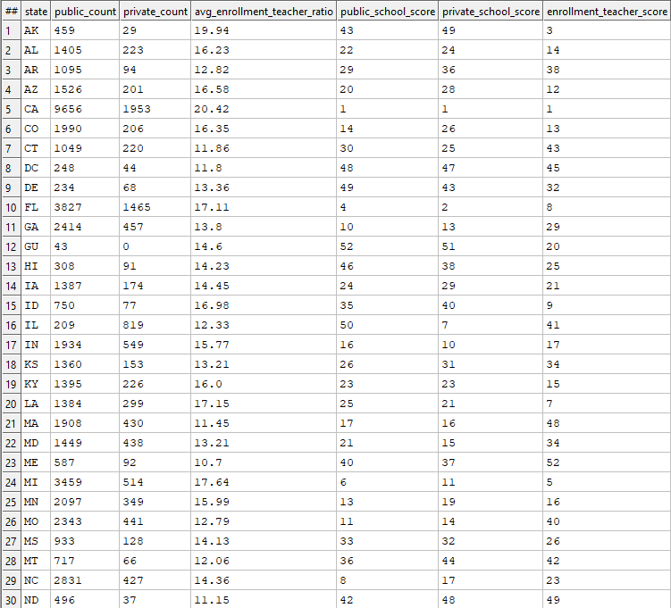
Education Dataset
Next we created a file called BWR_BuildEducationScores in which we gave scores/ranks to each state based on the number of private and public schools in each state and also for the average student enrolment ratio which we found during the analysis.
Here the Score/Rank is low for higher values of the ratios.

Slide 8
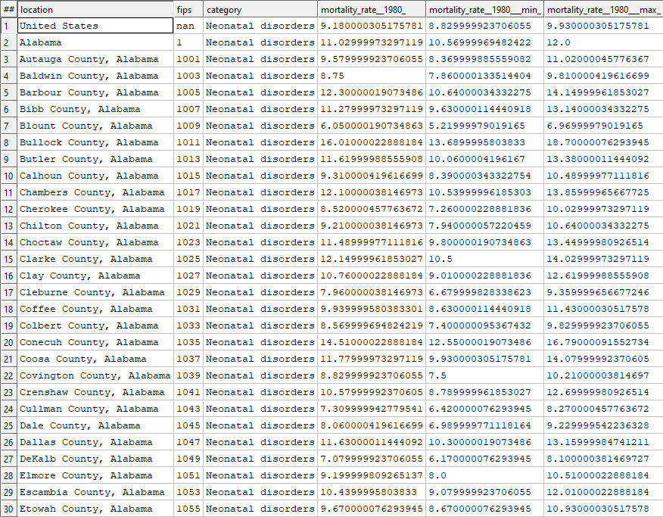
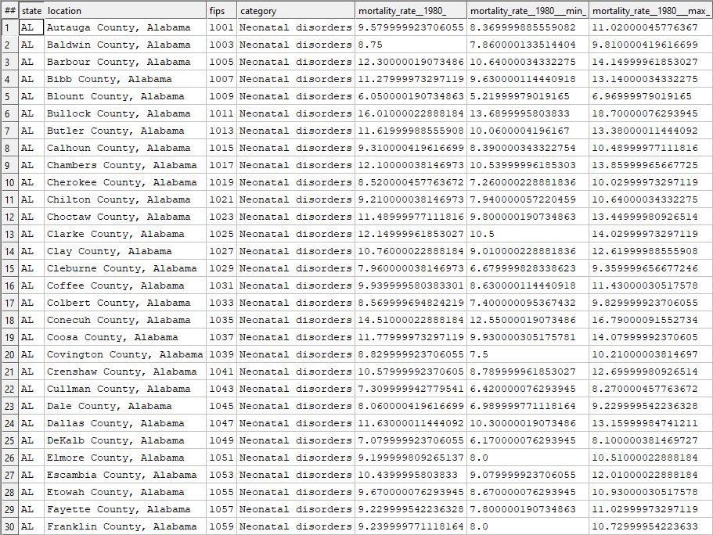
Health Dataset
For this dataset, it doesn’t have a state code, but it has State Fips code, hence we created a Record set which contains the Fips code and the respective state and we used JOIN function to add the State code column in the dataset of the file BWR_AnalyzeHealth.

Slide 9
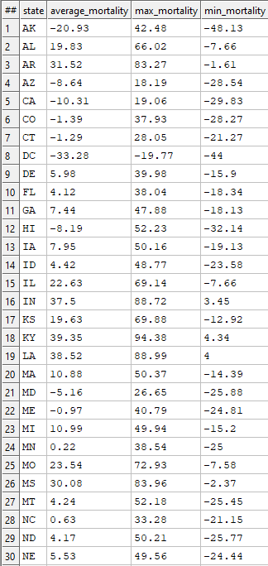
Health Dataset
Also we calculated the Average Mortality rate, Max and Min Mortality rates of respective states using GROUP function.

Slide 10
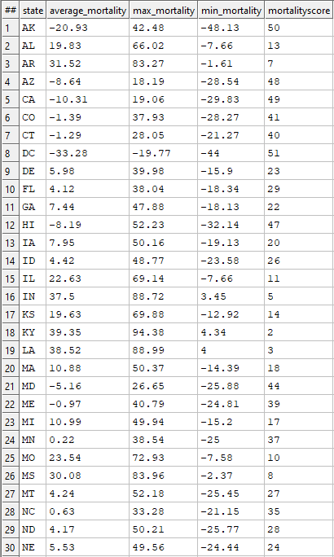
Health Dataset
Next we created a file called BWR_BuildHealthScore in which we added the scores for each state based on their average mortality rates, for this we used ITERATE function.

Slide 11
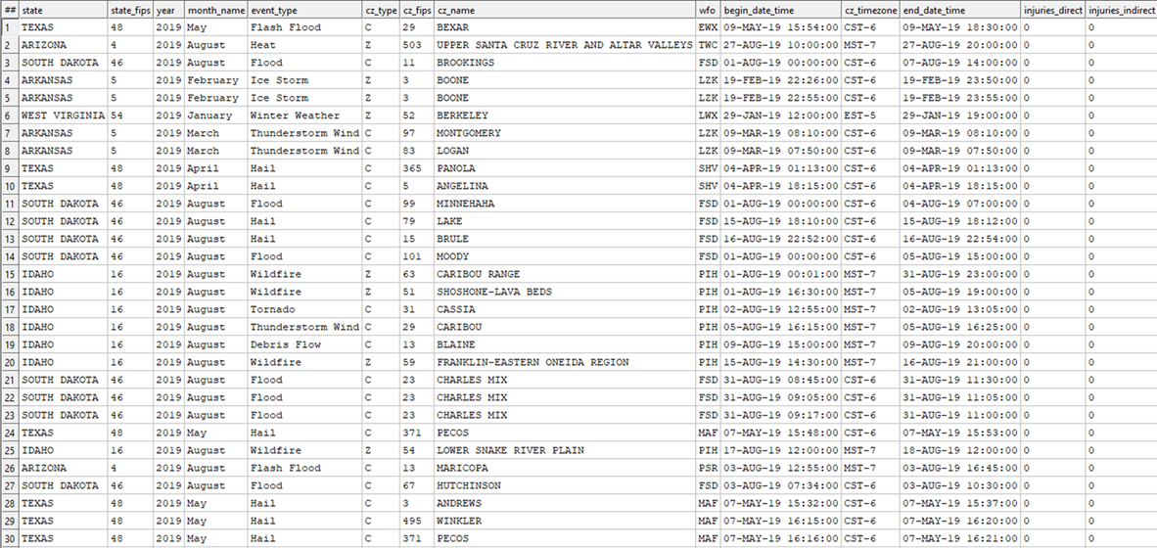
Weather Dataset
For this dataset also, we added the state code using the Fips code present in the dataset using JOIN function in the file BWR_AnalyzeWeather.

Slide 12
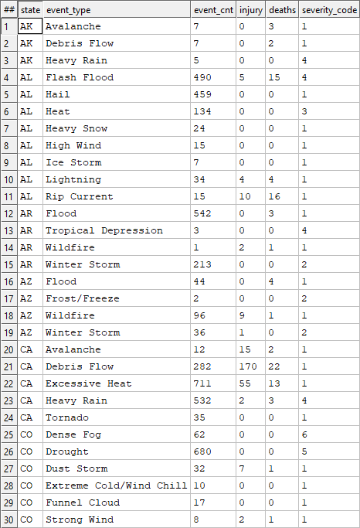
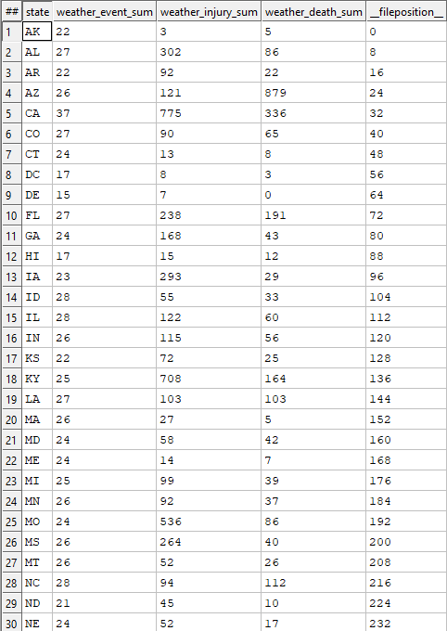
Weather Dataset
Next we created a Severity Count for each of the weather events; 1=Dangerous, 2=Cold, 3=Hot, 4=Wet, 5=Dry, 6=Other, and then added this column to the dataset using PROJECT function.
Then we Grouped Direct and Indirect Injuries to one single column, and the same for deaths too and counted them with respect to each state using COUNT and GROUP functions.

Slide 13
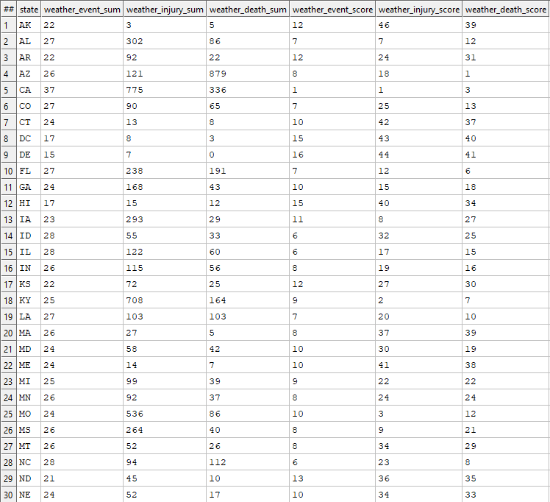
Weather Dataset
Next we created a file BWR_BuildWeatherScores in which we gave scores for each state based on the number of weather events, number of injuries and number of deaths.

Slide 14
Composite Dataset
Finally we created a record set by combining all the score values from the four datasets and stored it in File_Composite.
Next we created a file called BWR_BuildCompositeScores where first we add a column containing state names based on the state code using PROJECT function.
Next we merge all the Datasets i.e Crime, Education, Mortality and Weather using JOIN Function.
Next we add a column Paradise Score, which is sum of all the Scores of a state, using PROJECT function.

Slide 15
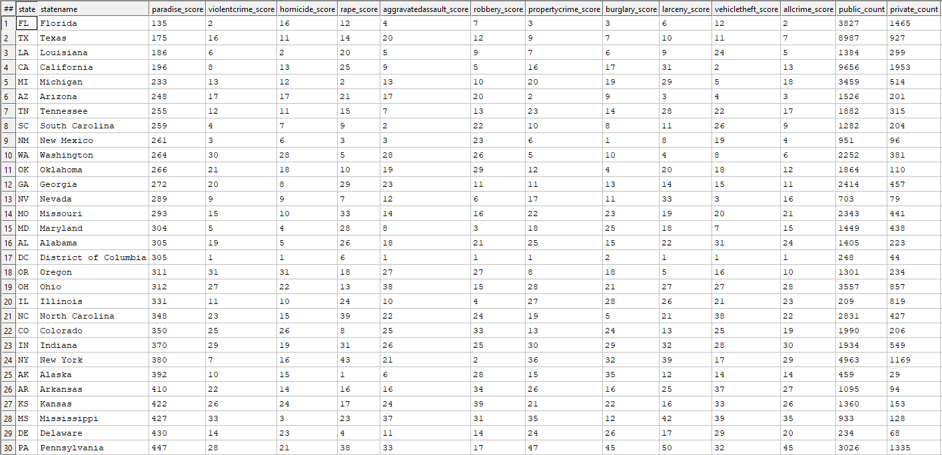
Composite Dataset

Slide 16
Data Delivery Using Visualization
Data Delivery Using Visualization is done using ECL Watch

